Slide 2
Introduction to
SIG Cluster Lifecycle
Justin Santa Barbara and Lubomir I. Ivanov

Slide 3

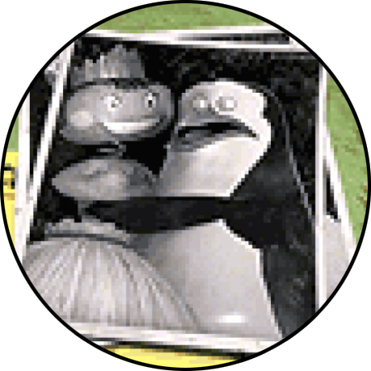
About
Justin Santa Barbara
SIG Cluster Lifecycle co-lead
Software Engineer @ Google
justinsb @ GitHub
Lubomir I. Ivanov
SIG Cluster Lifecycle co-lead
Software Engineer @ VMware OSPO
neolit123 @ GitHub

Slide 4
Agenda
What is SIG Cluster Lifecycle?
The mission and philosophy of the SIG
The stack of subprojects
Project Highlights
Cluster API
Component Config
Image Builder
Get Involved
How to contribute

Slide 5
What is SIG Cluster Lifecycle?

Slide 6

Mission
“SIG Cluster Lifecycle’s objective is to simplify creation, configuration, upgrade, downgrade, and teardown of Kubernetes clusters and their components.” Taken from the SIG charter document

Slide 7
Vision
Develop the tooling necessary to build a highly automated meta cloud:
Avoid the pitfalls of the past
Declarative API-driven k8s deployments
Managing clusters should be as easy as managing k8s Pods
Make the 80% use case simple and the 20% use case possible
Commoditize k8s cluster deployments

Slide 8
The Stack
k8s cluster provisioners
Cluster API
cluster-addons
image builder
ComponentConfig
kubeadm
etcdadm

Slide 9

Unix Philosophy
Make each program do one thing well
Make the boundary lines explicit
Set non-goals
~Every computing infrastructure project that initially meets one need well will eventually expand in scope to only meet several needs poorly.
Expect the output of every program to become the input to another program.
Using them together to form a Voltron-like software

Slide 10
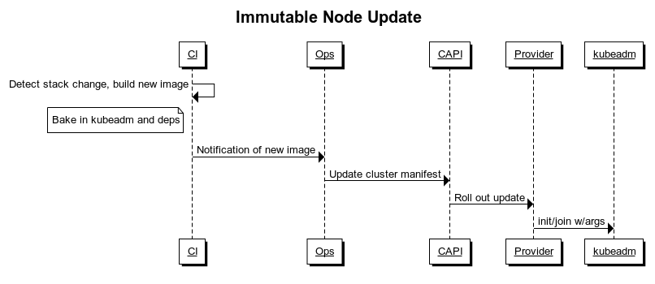
Pseudo Voltron Example

Slide 11
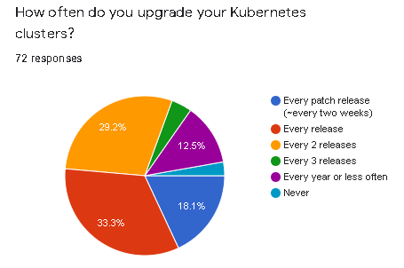
Survey for 2020
The SIG held a user survey during KubeCon EU 2020:
https://forms.gle/aYDTUekAdZtw414d6
Main takeaways:
Users are still struggling to keep up with the release cadence of k8s. There is currently a proposal to move to 3 releases per year instead of 4.
The upgrade process can be difficult due to core API deprecations.
Ubuntu (OS/VMs), Docker (CRI/dockershim), Calico (CNI) are still the most used projects in their respective areas.
Projects like kubeadm and Cluster API received positive feedback but need some UX improvements.

Slide 12
Project Highlights

Slide 13

Cluster API
Project repository: https://github.com/kubernetes-sigs/cluster-api
It is:
A declarative, Kubernetes-style API for cluster creation, configuration, and management across providers
Manages the lifecycle of other associated cluster infrastructure
An immutable (Node) deployment model
It is not:
A cloud provider abstraction layer
A tool that provides Node in-place upgrades

Slide 14
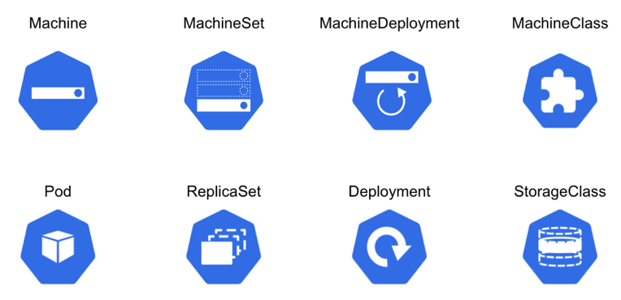
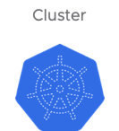
Cluster API: Design
Cluster API follows a familiar pattern
https://cluster-api.sigs.k8s.io/user/concepts.html

Slide 15
Cluster API: Roadmap
Optimize the UX where possible.
Get more feedback from the wild; see how users deviate from the defaults.
Automate all the things (build, deploy, test, release).
v1alpha3: better test plan, kubeadm control plane robustness, spot instance support, autoscaler, clusterctl extensible templating, etc.
v1alpha4: machine bootstrap failure detection, pluggable machine load balancers, support the latest kubeadm API, etc.
Towards Beta:
Better documentation.
Submit the project for API review.
Adoption goals:
Integration in Kops.
Make the existing Kubernetes e2e tests use Cluster API on GCP/AWS.

Slide 16
Cluster API: Learn More
Cluster API Deep Dive
Katie Gamanji, American Express & Carlos Panato, Mattermost
KubeCon NA 2020, Friday, November 20
https://sched.co/ekGv

Slide 17
ComponentConfig
ComponentConfig is a Kubernetes style API for configuring components
Problem 1: The core Kubernetes components are not consistent in how they are configured (they use a lot of flags).
Solution: Core components have started working on their ComponentConfig (kube-apiserver not yet)
Problem 2: It is pretty hard to write a k8s-like component with declarative config
Solution: Factor common component-related code into a `k8s.io/component-base` toolkit repository. Make it easier to write a non-core component that follows the k8s API style for its configuration. Existing components should be retrofitted to use the toolkit.

Slide 18
ComponentConfig
Maintainability: When $component’s flag set grows over 50+ flags, configuring it becomes painful
Upgradability: For upgrades, versioned configuration is easier to manage than flags, since flags are unversioned
Programmability: Configuration expressed as JSON/YAML objects allows for consistent manipulation - templating, patching, introspection
Possibility: Many types of config simply cannot be expressed as key-value pairs
Declarative: OpenAPI information can easily be exposed / used for doc generation
See Lucas Käldström’s talk on this here: Configuring Your Kubernetes Cluster on the Next Level

Slide 19
ComponentConfig: Learn More
This effort is driven by the Kubernetes Working Group - Component Standard
Visit their home page
Join the mailing list
Join #wg-component-standard on Slack

Slide 20
ImageBuilder
A tool for building virtual machine images:
https://github.com/kubernetes-sigs/image-builder
Includes:
Ansible / Packer scripts
Well supported from VMWare, Microsoft, etc for creating Cluster API images
Supports Ubuntu 18.04/20.04, CentOS, RHEL7, Photon, Amazon Linux, FlatCar (Coming Soon)
VMware, AWS, Azure, Qemu, Digital Ocean
Beginning of conformance test suite using GOSS
Other tools such as:
Kube-deploy used by Kops for image building
Konfigadm a tool for generating cloud-init, bash for configuration on images

Slide 21
ImageBuilder: Goals
Provide consistent tooling for all approaches so that we can create more standardized, reusable, and testable images
Make it easier for downstream consumers to customize their own images and keep their customizations up to date.
Testing of images to verify conformance
Reusable conformance testing tools (e.g. InSpec, GOSS)
Release of images for different cloud/OS combinations with regular updates.

Slide 22
ImageBuilder: Roadmap
Beta release of the CLI
PR testing for builds on AWS, GCP and Qemu. Azure based tests are already running on PRs.
Flatcar Support
Windows Support
Conformance testing / suites
Stress testing for log rotation, immutability
Test grid submissions for e2e testing
Image publishing/signing and release - Similar to the k8s container promotion process

Slide 23
ImageBuilder: Learn More
Image-Builder Deep Dive
Moshe Immerman, Flanksource & Tushar Aggarwal, VMware
KubeCon NA 2020, Thursday, November 19
https://sched.co/ekGv

Slide 24
Get Involved

Slide 25
Help Wanted
We need your help! There is still a lot of work to do in order to build voltron!
k8s cluster Provisioners
Cluster API
cluster-addons
ComponentConfig
image-builder
kubeadm
etcdadm
GA
Beta
Alpha
Pre-Alpha

Slide 26
How you can contribute
SIG Cluster Lifecycle New Contributor Onboarding
Navigate to our community page
Look for “good first issue”, “help wanted” labeled issues in our repositories
Help with docs and testing
Attend our Zoom meetings, and ask questions
Introduce yourself on Slack
Attend/Watch new contributor sessions (SIG ContribEx)
Chop wood, carry water, be kind
Everyone `earns` their place at the table (social capital)

Slide 27
Thank you!
Q / A

